Slide 1



Electrodeless Local Force Generator Using Magnetohydrodynamics for Aerocapture
Brendan Perry
University of Arizona
Arizona NASA Space Grant
Statewide Student Research Symposium
April 19th, 2025

Slide 2
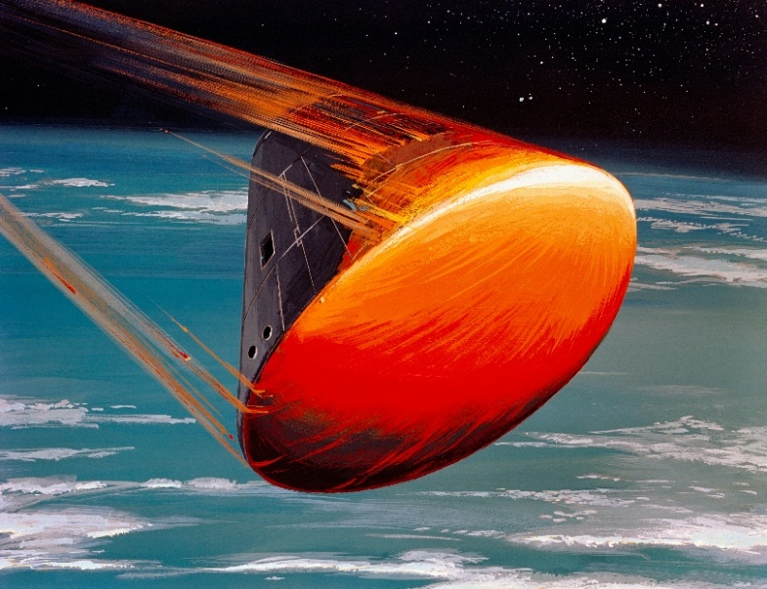

Introduction
Aerocapture: Orbital maneuver in which a spacecraft uses atmospheric drag through a planet’s atmosphere for trajectory control
Increase payload capacity
Reduce reliance on propulsion
Magnetohydrodynamics (MHD):
Study of the dynamics of electrically
conducting fluids → plasma
Source: NASA. (1968, August). Art Concept - Apollo VIII - Command Module (CM) - Re-Entry Orientation. NASA Image and Video Library. https://images.nasa.gov/details-S68-55292
Maximize cost efficiency per unit mass for space missions

Slide 3
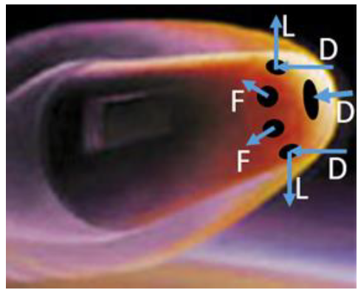
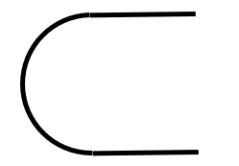
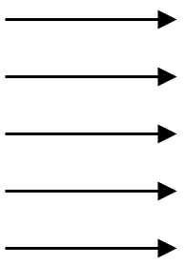








Objective
Evaluate effect of a local electrodeless MHD system on a re-entry spacecraft
Forces
Magnetic Fields
Mach Number
Does the induced magnetic field impact MHD forces?
$$M_{∞}$$
$$T_{∞}$$
$$P_{∞}$$
$$ρ_{∞}$$
Source: Moses, R. W., Cheatwood, F., Johnston, C. O., Macheret, S. O., Parent, B., Little, J., Williams, 10 R., Green, J. S., Austin, M., and Aldrin, A., “New MHD Lift Concept for More Efficient Missions to Mars and Neptune,” AIAA SCITECH 2022 Forum, 2022, p. 0934. https://doi.org/10.2514/6.2022-0934

Slide 4
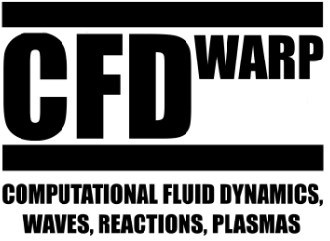
Methodology
Computational Fluid Dynamics (CFD)
Generate 3D spacecraft mesh
Validate mesh
Obtain 3D 11-Species solution
Probe flow properties under shock
Run MHD solver in local domain
Compile and interpret results

Slide 5
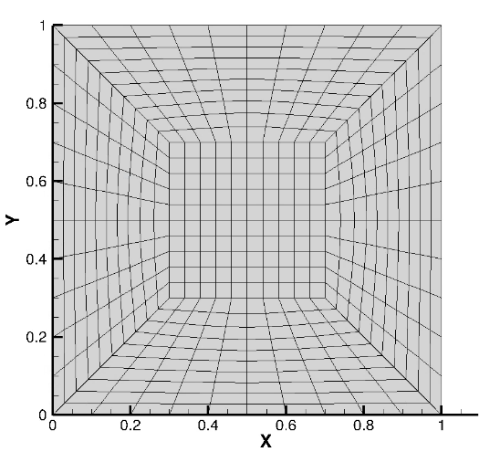
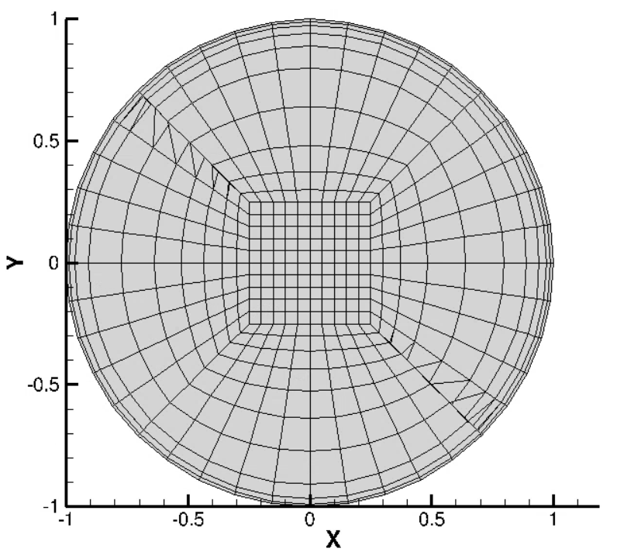
Mesh Evolution
2D Multi-Block Square
2D Multi-Block Circle

Slide 6
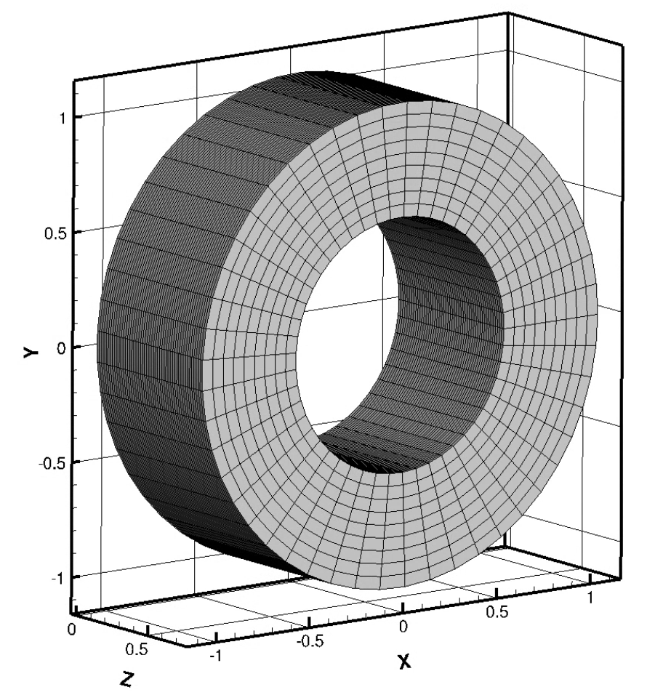
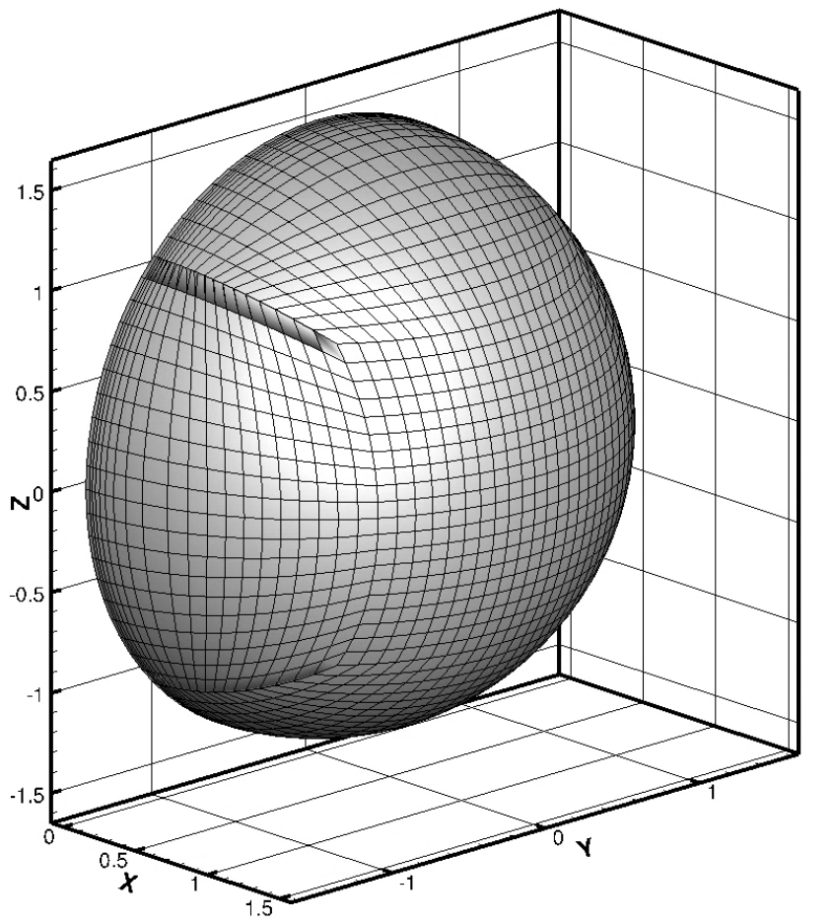
Mesh Evolution
3D Cylindrical Body
3D Spherical Nose Cone

Slide 7
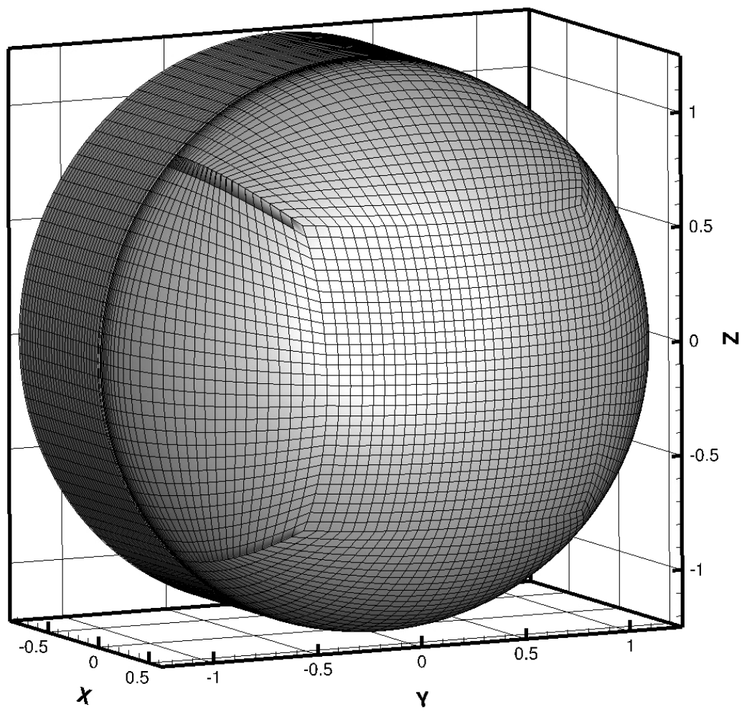
Mesh Evolution
Full 3D Spacecraft

Slide 8



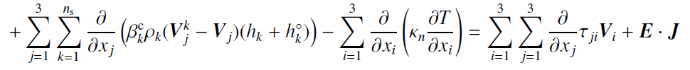
Physical Model
Navier-Stokes equations with electromagnetic field effects:

Slide 9

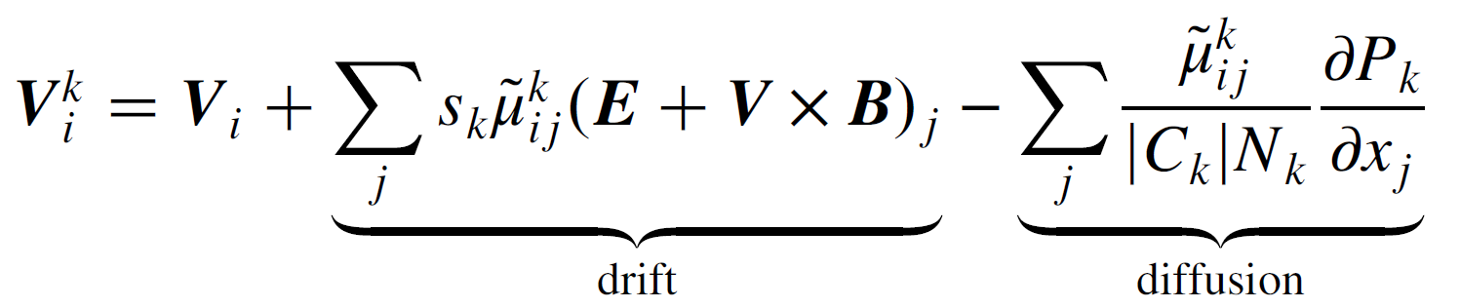
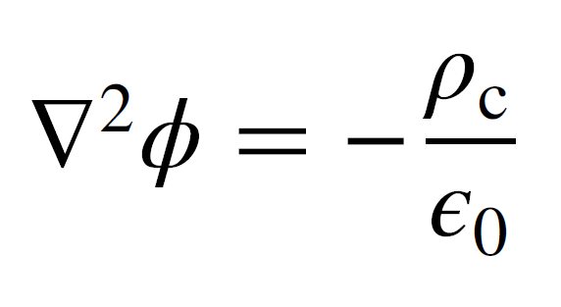
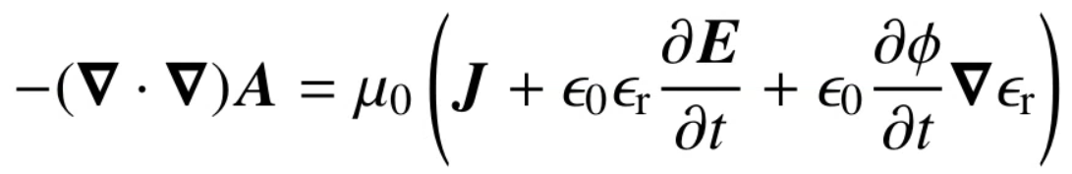

Physical Model
Electron energy transport equation:
Drift-diffusion model for charged species:
Electric potential equation based on Gauss’ Law:
Equations for obtaining induced magnetic field:

Slide 10
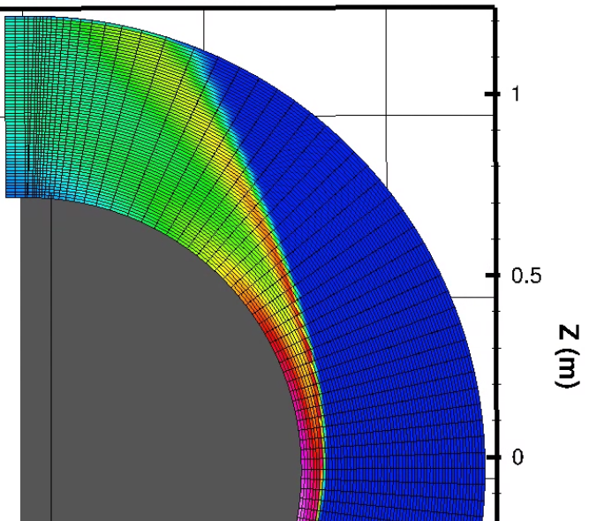
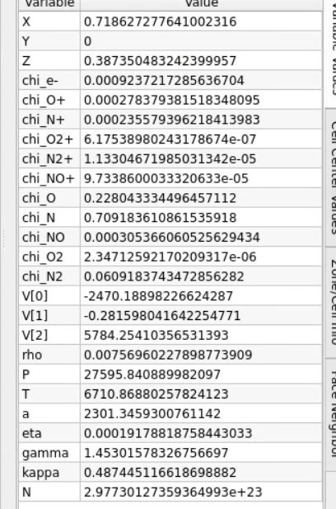
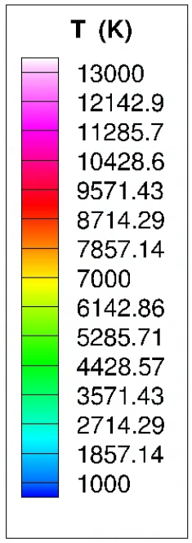
Analysis
Probed flow properties from 11-Species Air CFD solver

Slide 11
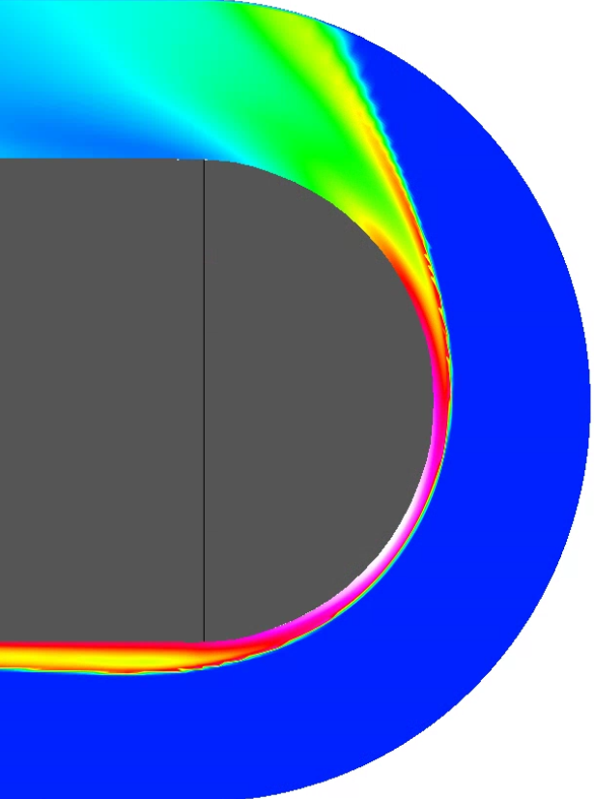
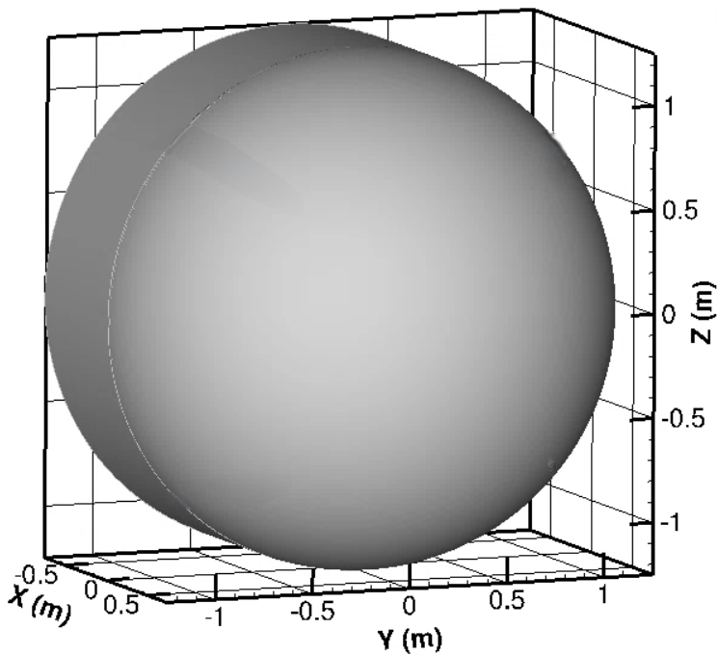
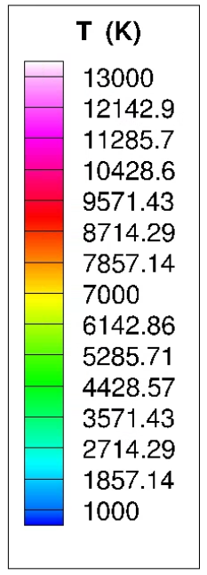
Analysis
Generated local domain to use with MHD solver
Inlet flow properties match probed values
MHD Domain

Slide 12
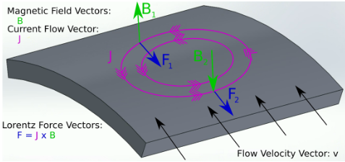
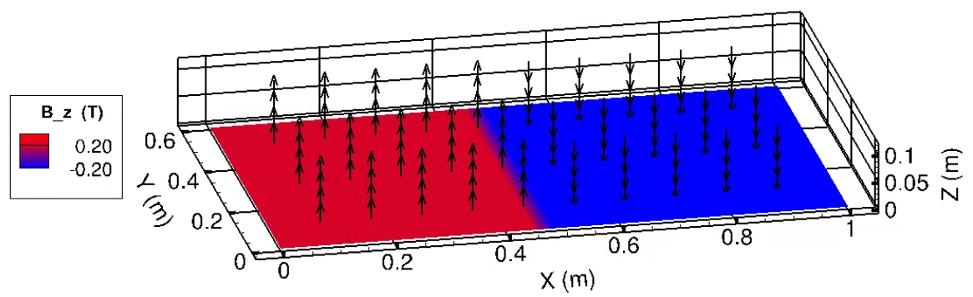
Analysis
Opposing magnetic fields, 0.2 T each
Source: Parent, B., Rodriguez Fuentes, F.M., and LaFoley, S., “Two-Electrode vs Electrode-less
MHD-Enhanced Aerocapture,” AIAA SCITECH 2024 Forum, 2024, AIAA Paper
2024-1649. https://doi.org/10.2514/6.2024-1649

Slide 13
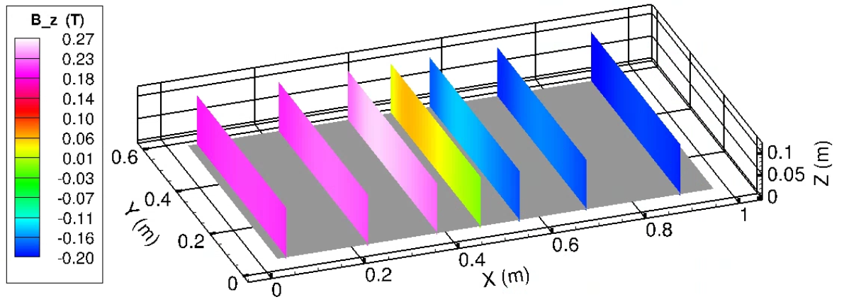
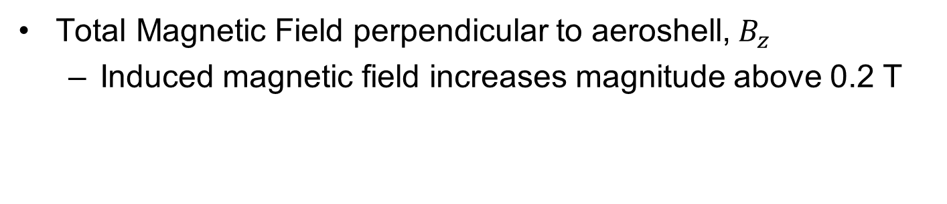
Results
Total Magnetic Field perpendicular to aeroshell,${ B}_{z}$
Induced magnetic field increases magnitude above 0.2 T

Slide 14
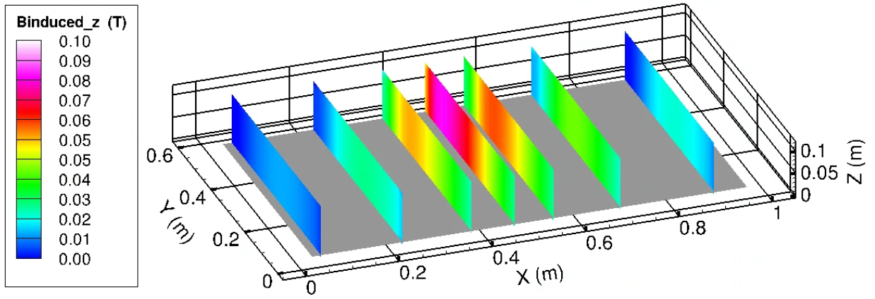
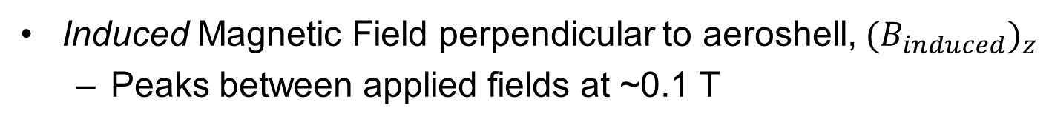
Results
Induced Magnetic Field perpendicular to aeroshell,${ {(B}_{induced})}_{z}$
Peaks between applied fields at ~0.1 T

Slide 15
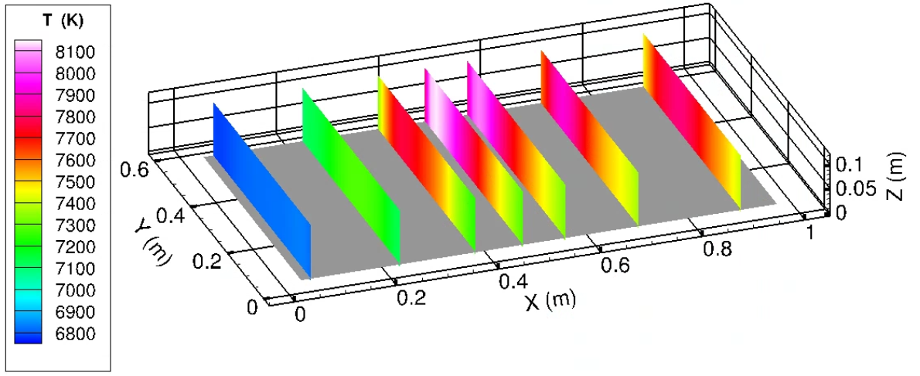
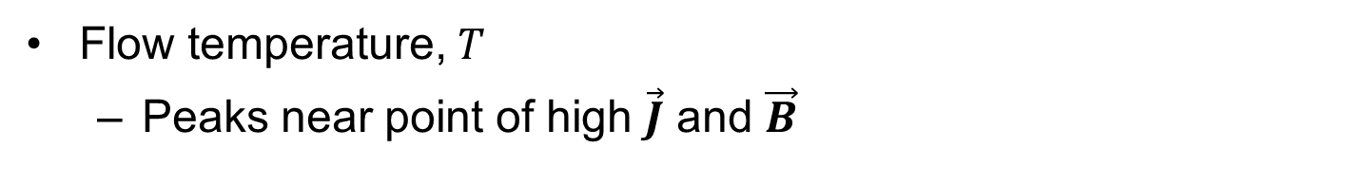
Results
Flow temperature, $T$
Peaks near point of high $\vec{J}$ and $\vec{B}$

Slide 16
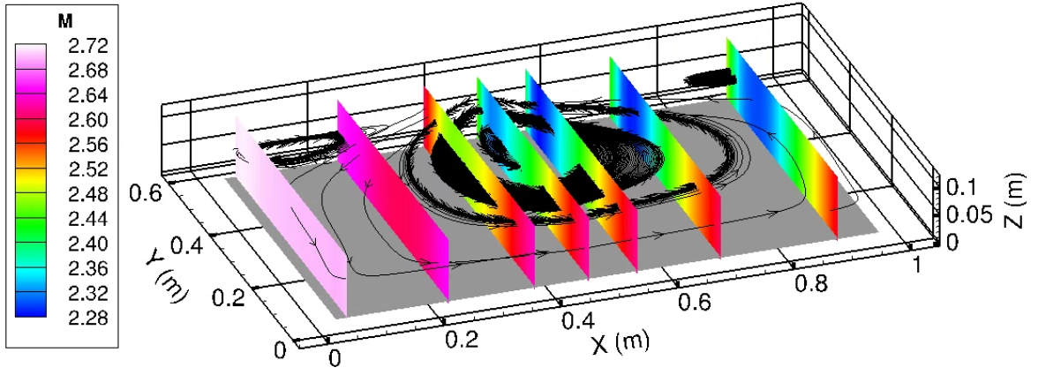
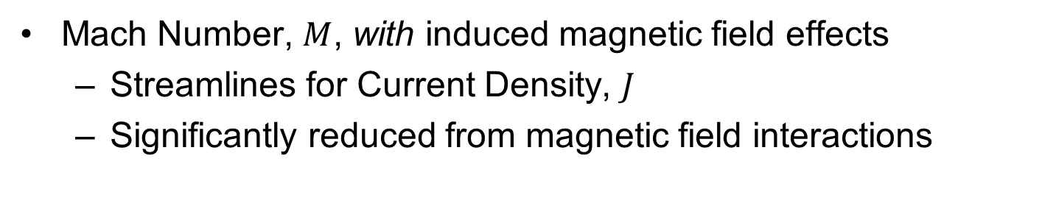
Results
Mach Number, $M$, with induced magnetic field effects
Streamlines for Current Density, $J$
Significantly reduced from magnetic field interactions

Slide 17
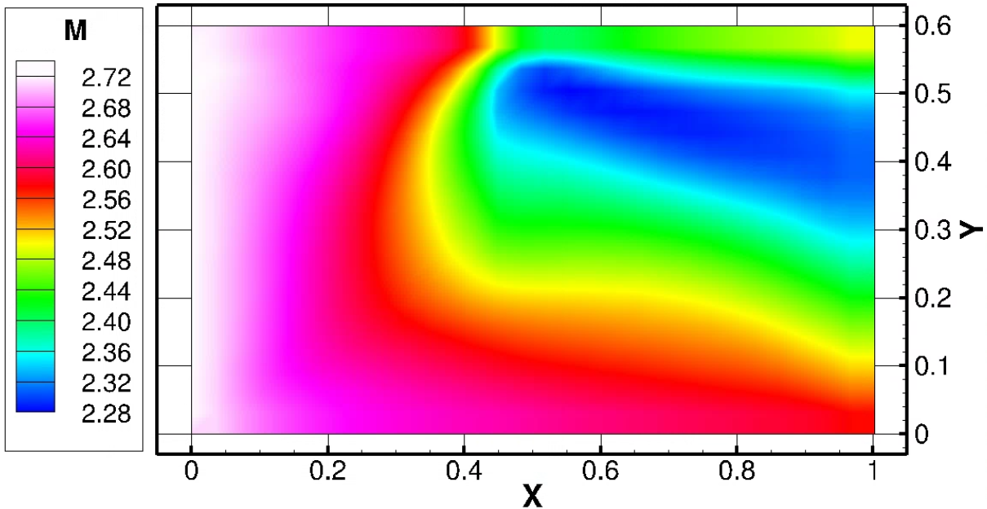
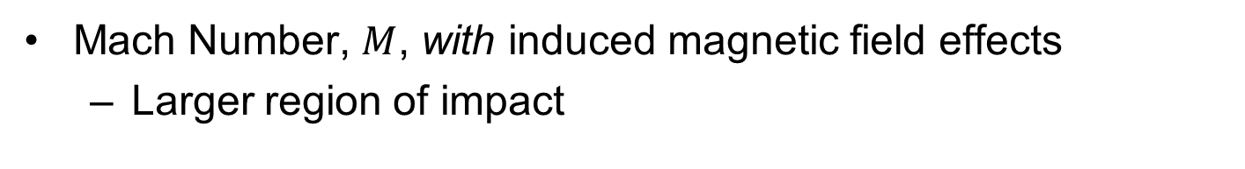
Results
Mach Number, $M$, with induced magnetic field effects
Larger region of impact

Slide 18
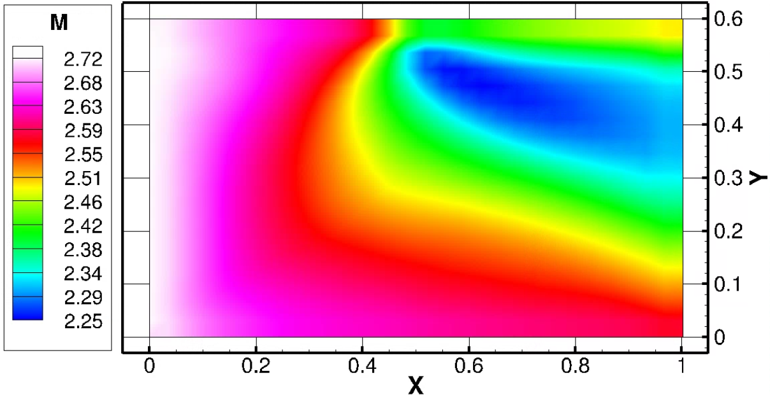
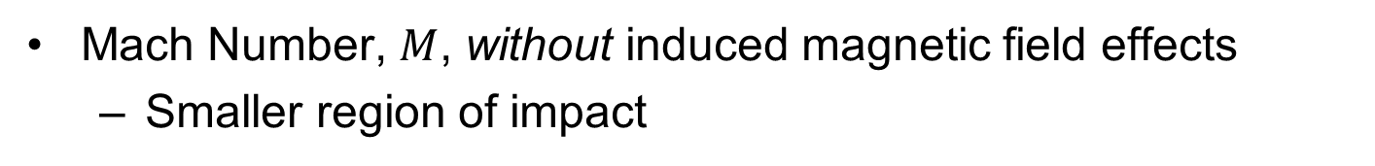
Results
Mach Number, $M$, without induced magnetic field effects
Smaller region of impact

Slide 19
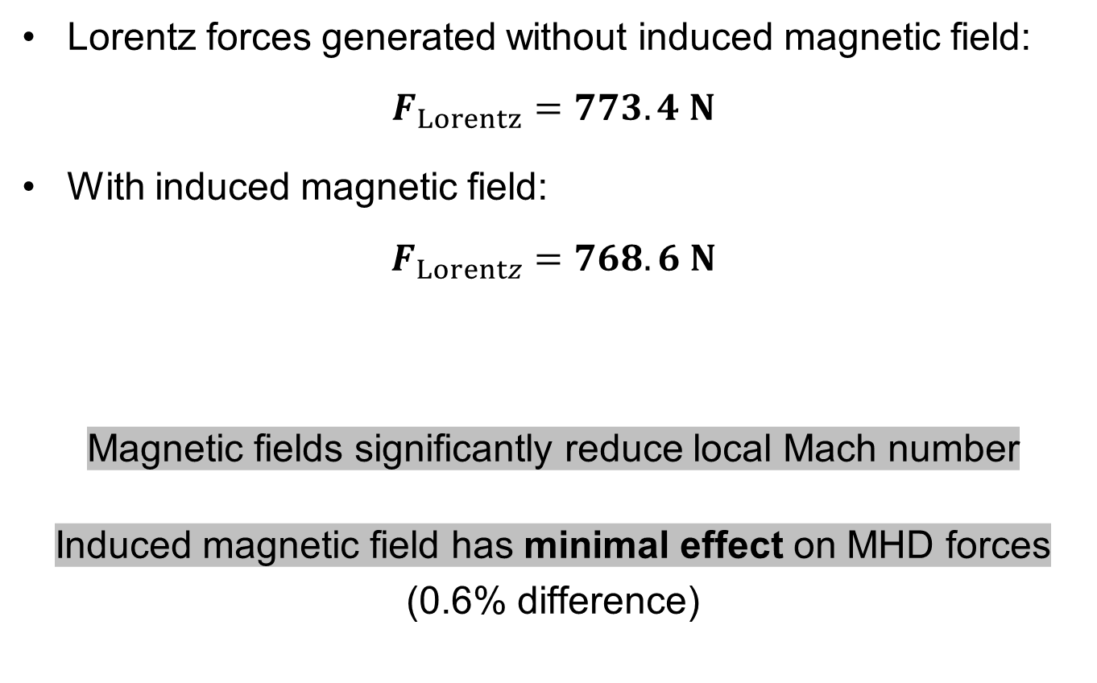
Results
Lorentz forces generated without induced magnetic field:
$$F_{Lorentz}=773.4 N$$
With induced magnetic field:
$$F_{Lorentz}=768.6 N$$
Magnetic fields significantly reduce local Mach number
Induced magnetic field has minimal effect on MHD forces
(0.6% difference)

Slide 20
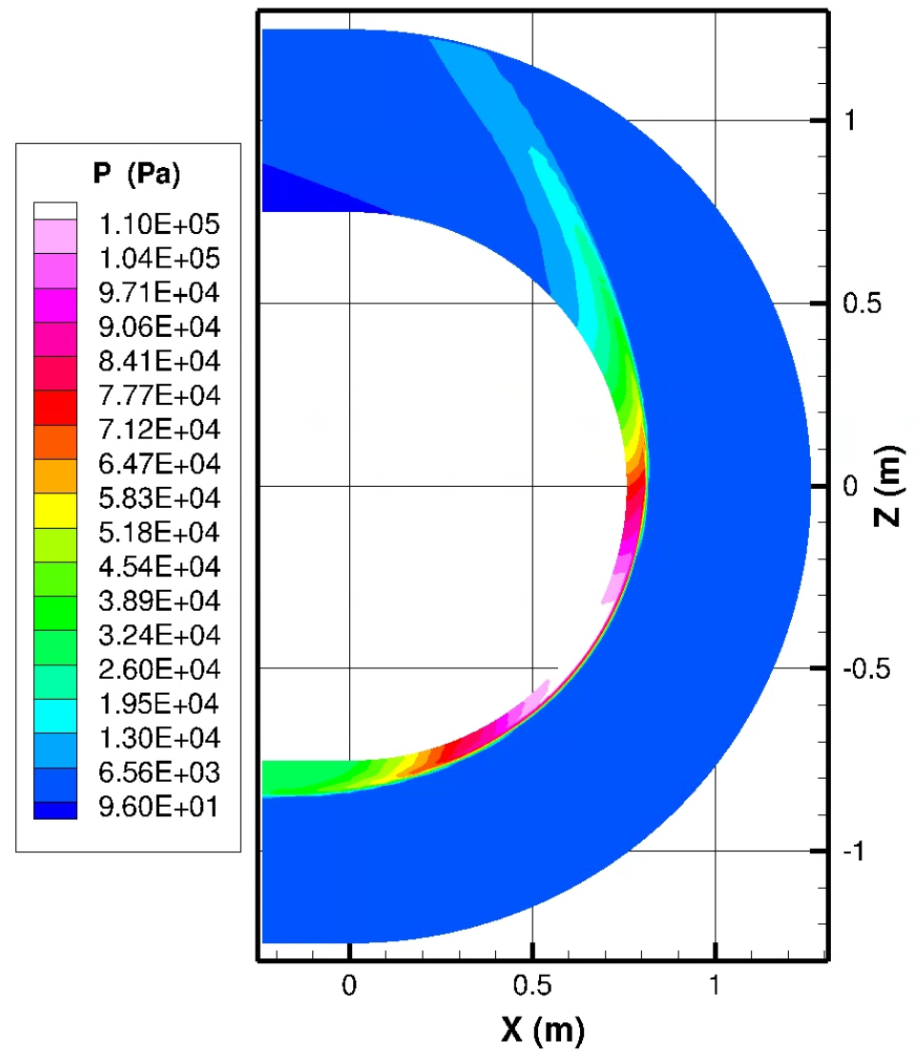

Conclusion
An electrodeless MHD system offers a viable solution for aerocapture in re-entry space missions
Generated 3D spacecraft mesh
11-Species Solution
Local MHD Solution
$$\vec{F}, M, \vec{B},\vec{J},…$$

Slide 21
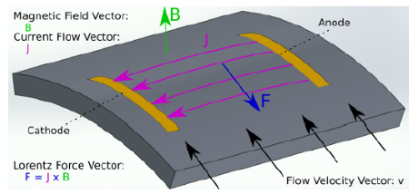
Next Steps…
3D two-electrode system
MHD Optimization
Plasma sheath accuracy
Source: Parent, B., Rodriguez Fuentes, F.M., and LaFoley, S., “Two-Electrode vs Electrode-less MHD-Enhanced Aerocapture,” AIAA SCITECH 2024 Forum, 2024, AIAA Paper2024-1649. https://doi.org/10.2514/6.2024-1649

Slide 22
Acknowledgements
Dr. Bernard Parent - Associate Professor of Aerospace and Mechanical Engineering; Head of CPRFLOW Lab
Michelle Coe - Arizona Space Grant Consortium Program Manager
Dr. Chandra Holifield Collins - NASA Space Grant Associate Director
Felipe Rodriguez Fuentes - CPRFLOW Lab Member

Slide 23
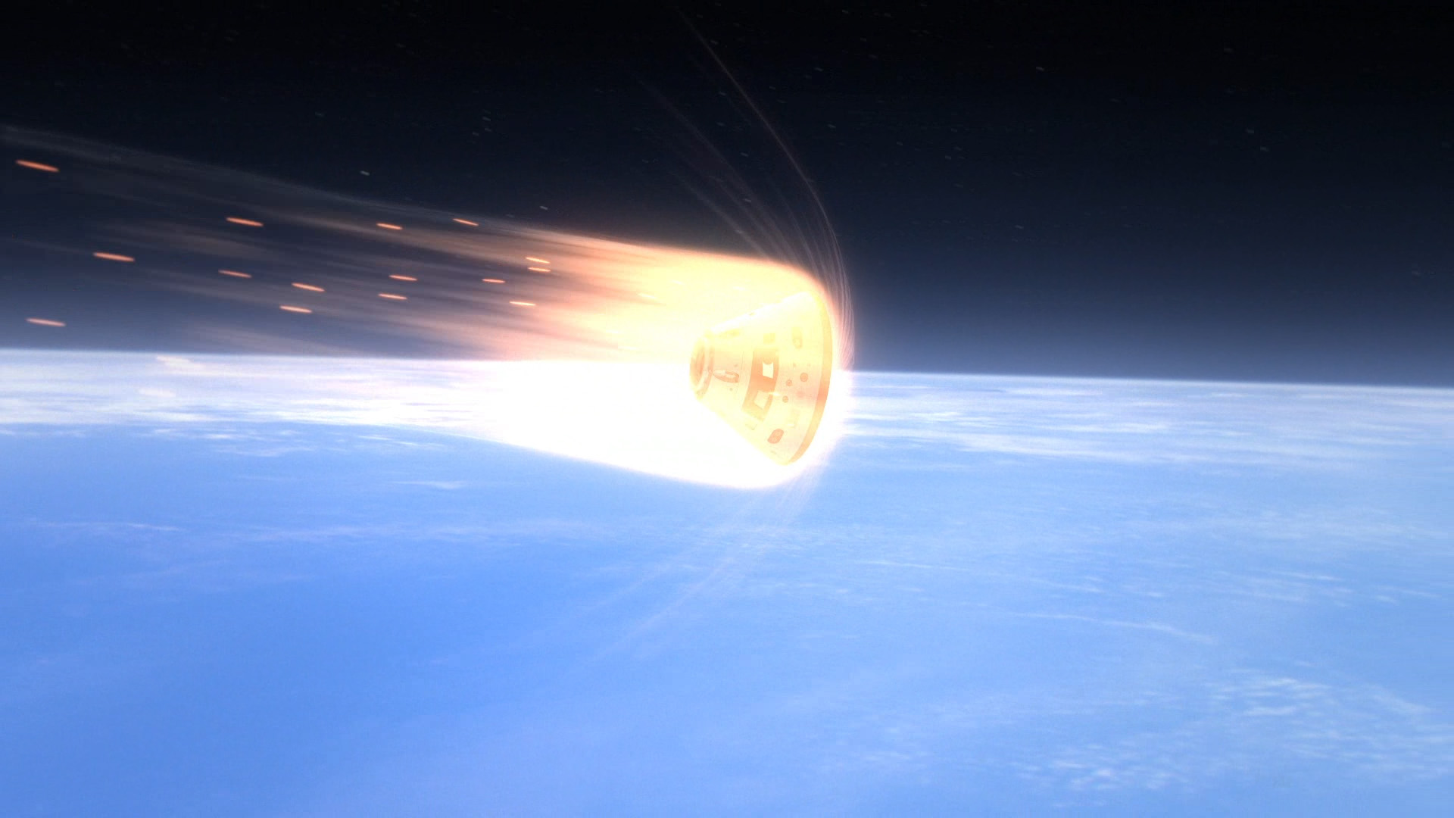

Thank you!
Source: Canadian Space Agency. “Orion Spacecraft Enters the Earth’s Atmosphere (NASA)” Canadian Space Agency, / Gouvernement du Canada, 29 Sept. 2023, www.asc-csa.gc.ca/eng/multimedia/search/image/8283.

